Slide 1


Welcome!
Lunchtime webinar: Seeing is Believing - Local Authority Matchmaking (North East & Yorkshire)
  John Taylor, Head of Capacity Building & Strategic Development, Community Energy England
Today, we will also be hearing from:
  Abbie Rodger, Net Zero Hub Project Manager (North East and Yorkshire region)
  Sarah Burgess, Grand Union Community Energy
  Issy Burkitt, City of York Council

Slide 2
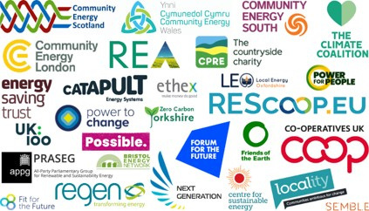

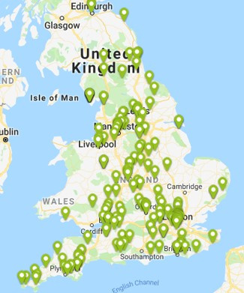
Community Energy England (CEE)
Community Energy England (CEE) is the national network and representative body for community energy.
  A voice for the sector
  We provide opportunities and mechanisms for active community energy practitioners in all parts of England to connect, learn, share business models and help each other overcome obstacles
340+ members
  Community energy organisations, sector stakeholders and other supportive organisations

Slide 3
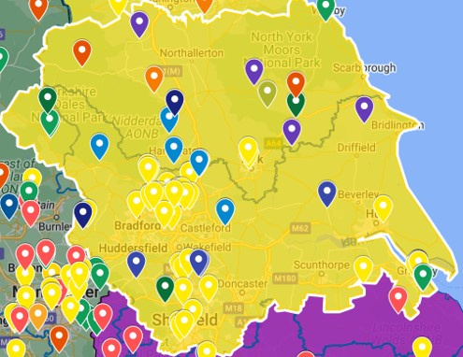
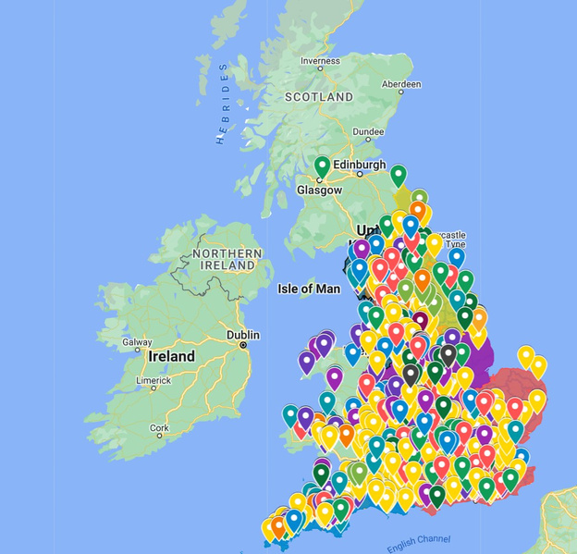
Community Energy: Nationally and regionally
Our national map represents the most comprehensive dataset of community energy groups, projects and their locations, that we know to exist nationally.

Slide 4
An introduction to “Seeing is Believing”
  Funded by the North East and Yorkshire Net Zero Hub
  Delivered by Community Energy England, Ashden, and Centre for Sustainable Energy
  Sharing inspiring stories (site visits, networking, events, etc.)
  Showing how collaborations got started, what’s worked well, and how you can get involved
  Brings together politicians, local authorities, civil servants, voluntary sector organisations, and community energy enterprises

Slide 5
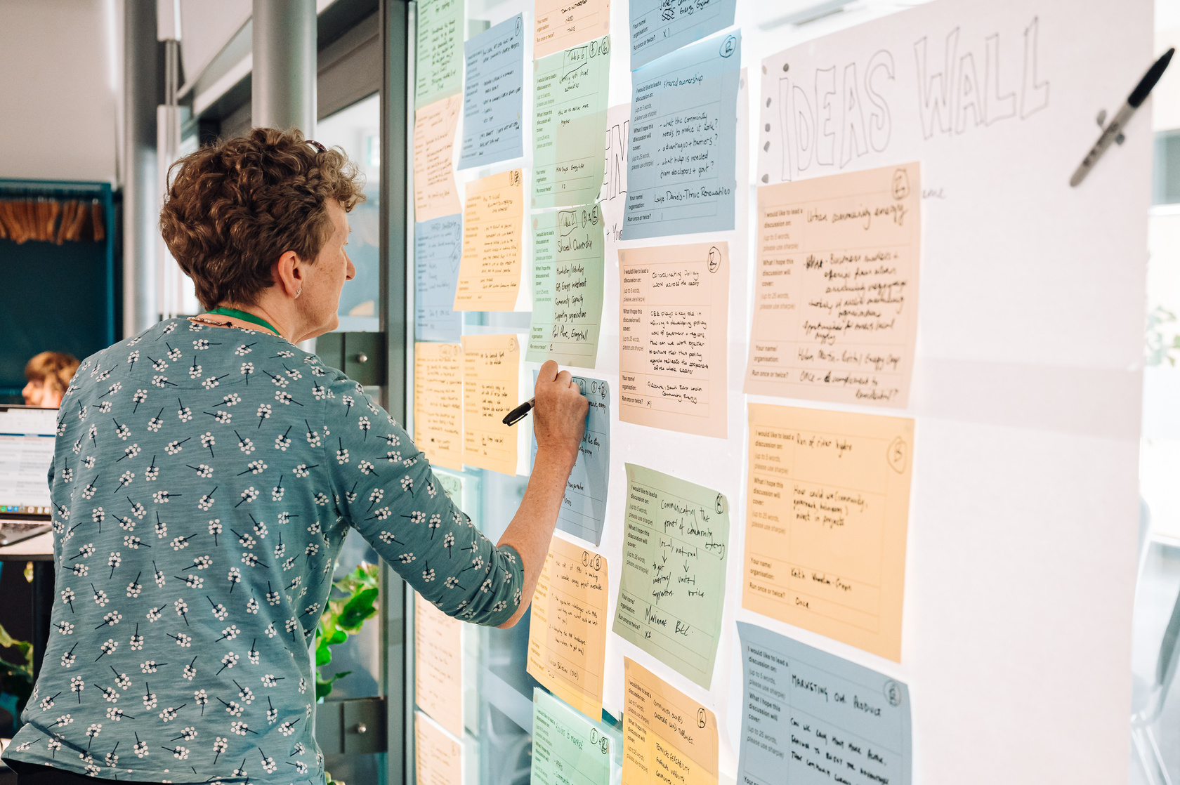
Seeing is Believing
Local authority matchmaking work:
  Connect local councils and community energy groups
  Site visits and tours
Upcoming events:
  Weds 26th Nov, 10 am - 4pm, York: Tour
  Thurs 4th Dec, 10 am - 4 pm: Tour and networking

Slide 6


Other programmes
The Energy Learning Network:
  Free insights, resources and connections for existing community energy groups
  Mentoring and peer learning opportunities
  Collaboration between CEE, Ashden, the Centre for Sustainable Energy, Community Energy Scotland, Community Energy Wales, and Northern Ireland’s Action Renewables.
Community Energy GO:
  Connect community groups across England with expert advice, practical tools and hands-on support.
  Free, tailored to help develop renewable energy or low-carbon projects.

Slide 7
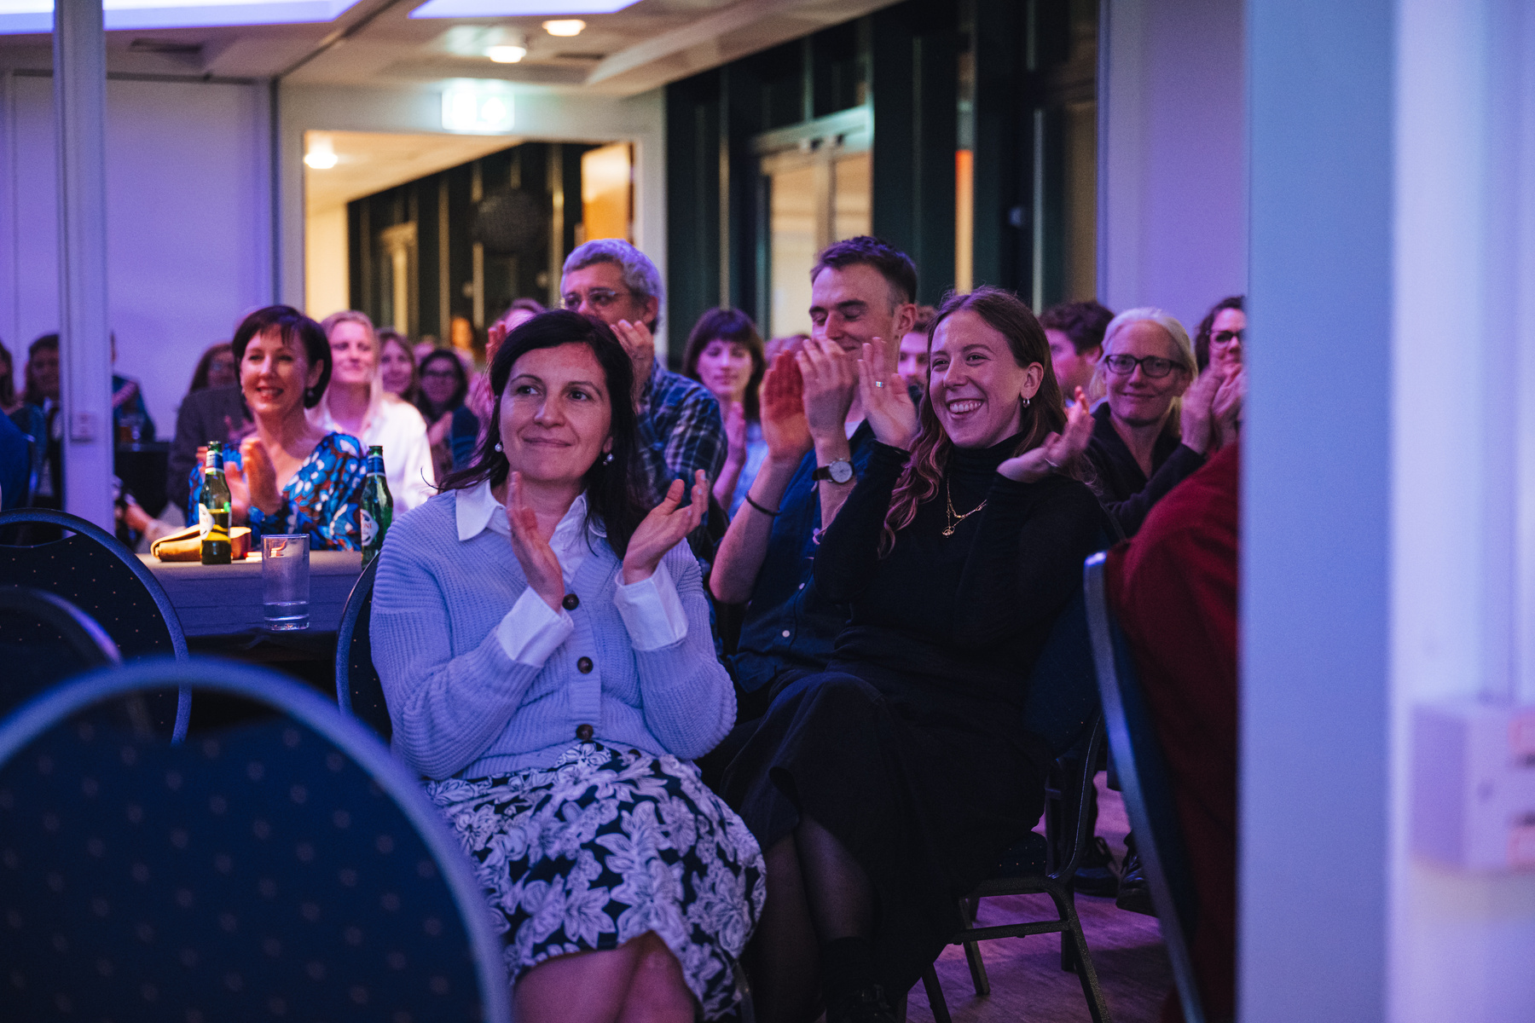
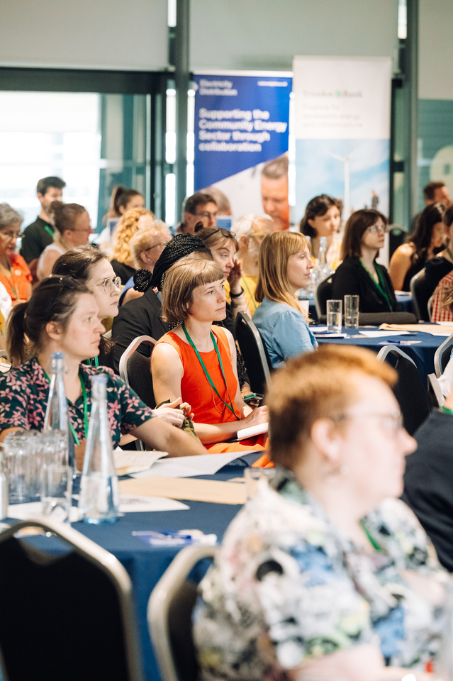
Upcoming events
  Winter Conference, 17 November (Sheffield) - join the waiting list
  Community Energy Awards, 17 November (Sheffield) - RSVP now
  Maximising income from your community energy project - 2 December (Online)
  The next phase of community energy: Supermarkets and warehouses - 4 December (Online)

